Slide 1

TensorFlow Hub

Slide 2
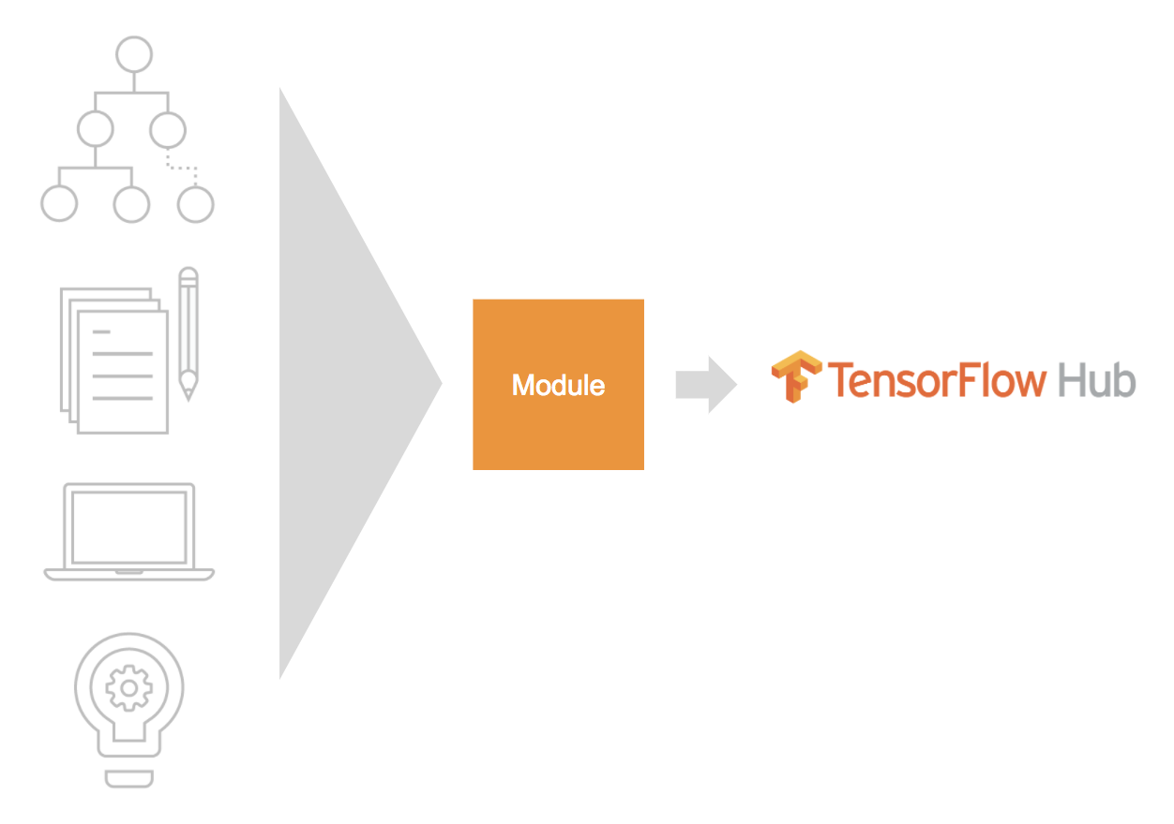
TensorFlow Hub
TensorFlow Hub is a library for the publication, discovery, and consumption of reusable parts of machine learning models.
Module: a self-contained piece of a TensorFlow graph, along with its weights and assets, that can be reused across different tasks in a process known as transfer learning.
Notes:
Tensorflow hub is a market place and API that let’s you use parts of pre-trained models (modules) in your own model with simple code.
Resources:
https://www.tensorflow.org/hub
https://blog.lipishala.com/2019/01/27/introduction-to-tensorflow-hub/

Slide 3
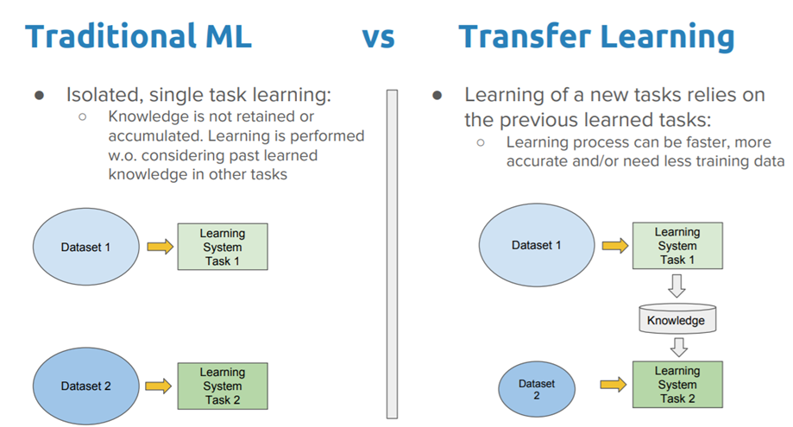
Transfer Learning
Transfer Learning is a process of using prebuilt models to improve the performance of a new model.
Train a model with a smaller dataset
Improve generalization
Speed up training
Notes:
Resources:
https://www.tensorflow.org/hub
https://towardsdatascience.com/a-comprehensive-hands-on-guide-to-transfer-learning-with-real-world-applications-in-deep-learning-212bf3b2f27a

Slide 4
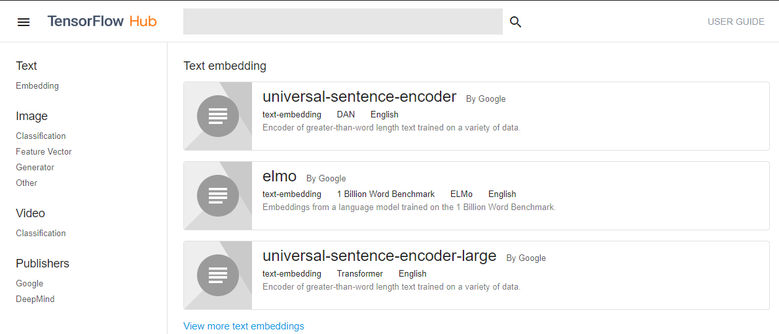
Transfer Learning
https://tfhub.dev/
Notes:
At tfhub.dev we can find the modules for download and use. You’ll notice that the publishers only include Google and DeepMind, but they will be supporting third party modules. Let’s check out the website to see the different types of modules.
Resources:
https://tfhub.dev/

Slide 5
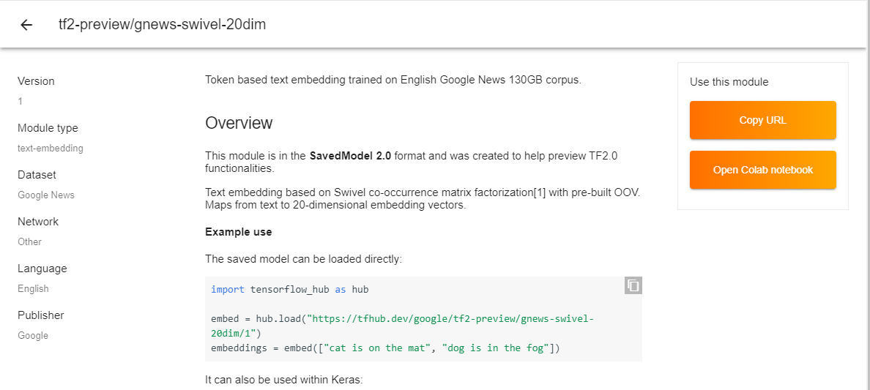
Gnews
Notes:
In our code along we are going to use the Google Text embedder trained on Google’s 130Gb news cuprous. Text embedding is a way of transforming words into an array of numbers in a way that still contains things like sentence structure and phrasing a computer can understand.
Resources:
https://tfhub.dev/google/tf2-preview/gnews-swivel-20dim/1

Slide 6
IMDB Movie Reviews Dataset
50,000 Reviews
30 reviews per movie
1-4 negative ratings
7-10 positive ratings
Notes:
Our code along will be using the IMBD movie reviews dataset to build a model that can predict the rating of a review.
This dataset has:
50,000 reviews (25k for training and 25k for testing)
30 reviews per movie
Reviews only have a score from 1-4 (negative) or 7-10 (positive)
Resources:
https://www.kaggle.com/iarunava/imdb-movie-reviews-dataset

Slide 7

Google Colab
Notes:
Notes for the Code:

